Slide 1
Cross Border Payments

Slide 2
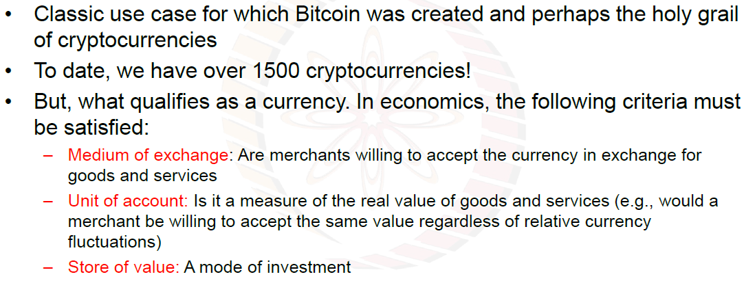
Cross Border Payments

Slide 3
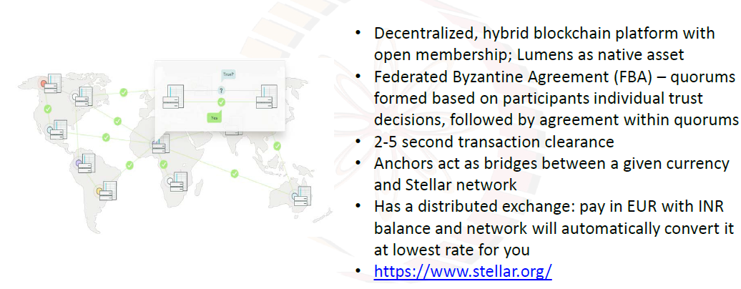
Stellar Protocol and Network

Slide 4
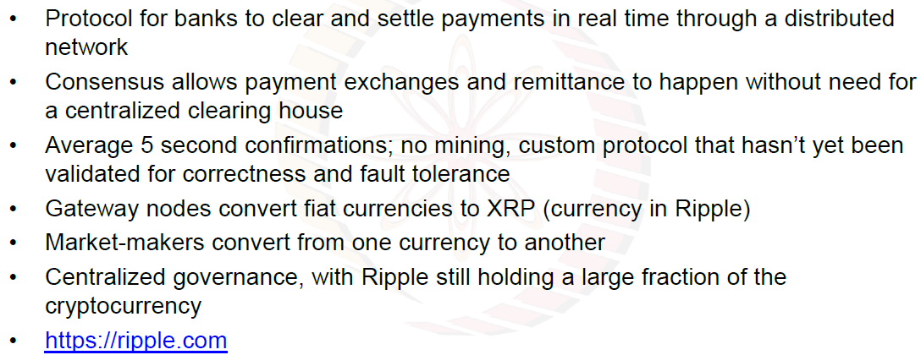
Ripple Protocol and Network

Slide 5
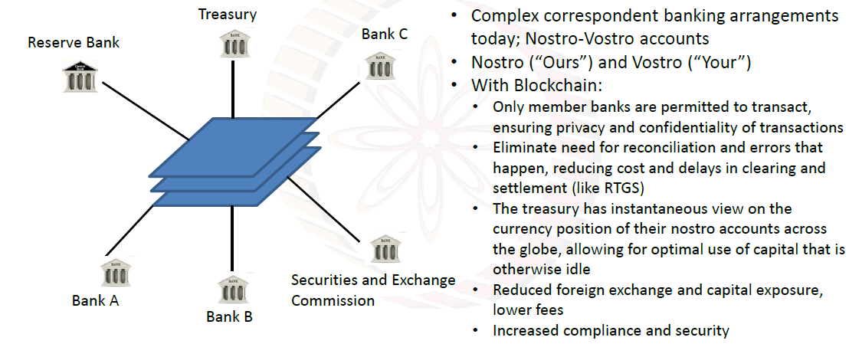
Permissioned Networks for Payments and Settlement

